Slide 1
🎯 Slide 1: Project Overview
Objective
➡️ Analyze global sales and profit data across regions and categories
➡️ Identify key trends and forecast future growth using Excel and Power BI Problem Statement
🔍 A global retail chain wants to understand where it’s growing, which categories are profitable, and how to plan for the future.

Slide 2
Slide 2: Dataset Information
Source: Kaggle (CSV/Excel file)
Main Columns:
Region – Area of sales (e.g., Asia, Europe)
Category – Product categories (e.g., Electronics, Fashion)
Parameter – Sales or Profit
Mode – Mode of selling (e.g., Online, Retail)
Power train – Product feature (if applicable)
Year – From 2011 to 2035
Unit – e.g., Number of units
Value – Numeric value of sales/profit

Slide 3
Slide 3: Step 1 & 2 – Download and Clean Data (Excel)
Step 1: Download
✅ Download the dataset from Kaggle in Excel format
Step 2: Clean the Data
🧼 Tasks Done in Excel:
Removed blanks and errors
Verified numeric values
Sorted years in ascending order
Split data into Sales and Profit views
Added totals per region/category if needed

Slide 4
Slide 4: Step 3 – Identify Regional & Category Trends
Using Excel Pivot Tables:
Insert Pivot Table
2. Rows → region
3. Columns → year
4. Values → Sum of value
5. Filters → parameter (Sales or Profit)
📌 Repeat for category
📊 Output: Trend tables showing how each region/category performed over time
Step 4 – Forecasting in Excel

Slide 5
Slide 5: Step 5 – Power BI Setup
Import Data:
Open Power BI → Get Data → Excel → Select file
Transform Data:
Ensure correct data types (Year = number, Value = decimal)
Remove blanks
Apply filters if needed

Slide 6
Slide 6: Step 6 – Power BI Visuals
Line Chart – Sales/Profit over years
Axis: Year | Value: value | Legend: parameter
2. Stacked Column Chart – Sales by Region
Axis: Region | Value: value
3. Area Chart – Category trend
Axis: Year | Value: value | Legend: category
4. Slicers – For interactivity
region, category, parameter

Slide 7
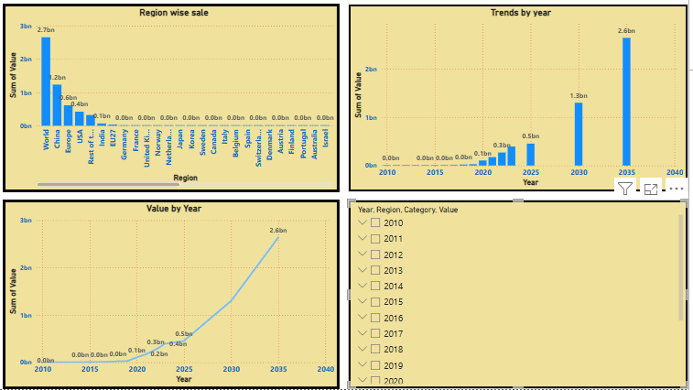

Slide 8
Slide 8: Summary of Insights
🔼 Sales and profits increased consistently in Asia & Europe
📦 Electronics and Fashion led in category performance
🔮 Forecast suggests growth will continue till 2035
🚩 Outliers detected in some years/regions – need further investigation

Slide 9
Slide 9 : Tools & Skills Used
Tool | Purpose
Excel | Data cleaning & forecasting
Power BI | Visualization & interactivity
DAX | Outlier logic & filters
Pivot Table | Category/Region analysis

